Slide 1
Chapter 4: Software Requirements Elicitation

Slide 2
Key Takeaway Points
Requirements are capabilities that the system must deliver.
The hardest single part of building a software system is deciding precisely what to build—i.e., the requirements. (Frederick P. Brooks, Jr.)
Software requirements elicitation is aimed to identify the real requirements for the system.

Slide 3
The Planning Phase
The planning phase has three activities:
  requirements elicitation
  deriving use cases from the requirements, and
  producing an iterative development plan
It requires the team to work closely with the customer and users
  to help them identify the needs for their business
  to help them determine the real requirements for the future system
  to help them prioritize the requirements

Slide 4
Requirements Elicitation
Requirements are capabilities (stated as part of a contract) that the system must deliver.
Requirements are documented in a requirements specification, which serves as part of the contract.
Requirements elicitation is the process to identify and formulate the capabilities for the software system.

Slide 5
Requirements Elicitation in Software Lifecycle
System Engineering
Requirements Engineering/ Requirements Elicitation
Software Design
Implementation
Testing
Deployment & Maintenance

Slide 6
Requirements Elicitation in Methodology Context
Business goals
& needs
Current situation
Use case-iteration allocation matrix
Accommodating
Requirements Change
Customer
feedback
Requirements Elicitation
Iteration use cases
Domain Modeling
Preliminary requirements
Domain model
Domain model
Deriving Use Cases
from Requirements
Actor-System Interaction Modeling
Abstract & high level use cases, use case diagrams
Expanded use cases & UI design
Allocating Use Cases & Subsystems
to Iterations
Behavior Modeling &
Responsibility Assignment
Behavior models
Use case-iteration allocation matrix
Deriving Design Class
Diagram
Producing an Architecture Design
Design class diagram
Software architecture
Test Driven Development, Integration, & Deployment
(a) Planning Phase
(b) Iterative Phase – activities during each iteration
control flow
data flow
control flow & data flow

Slide 7
Requirements Elicitation Activities
Identifying problems and needs
Constructing analysis models to help understanding
Formulating system/software requirements
Conducting feasibility study
Checking the requirements and models for desired properties such as correctness, and consistency
Specifying acceptance tests
Formulating an iterative development plan

Slide 8
Importance of Requirements Elicitation
The requirements specification is part of the contract, which bears legal consequences.
  Numerous lawsuits are related to systems not satisfying the requirements and constraints.
37% of all software development problems are related to requirements.
Poorly identified requirements significantly increase the development costs.

Slide 9
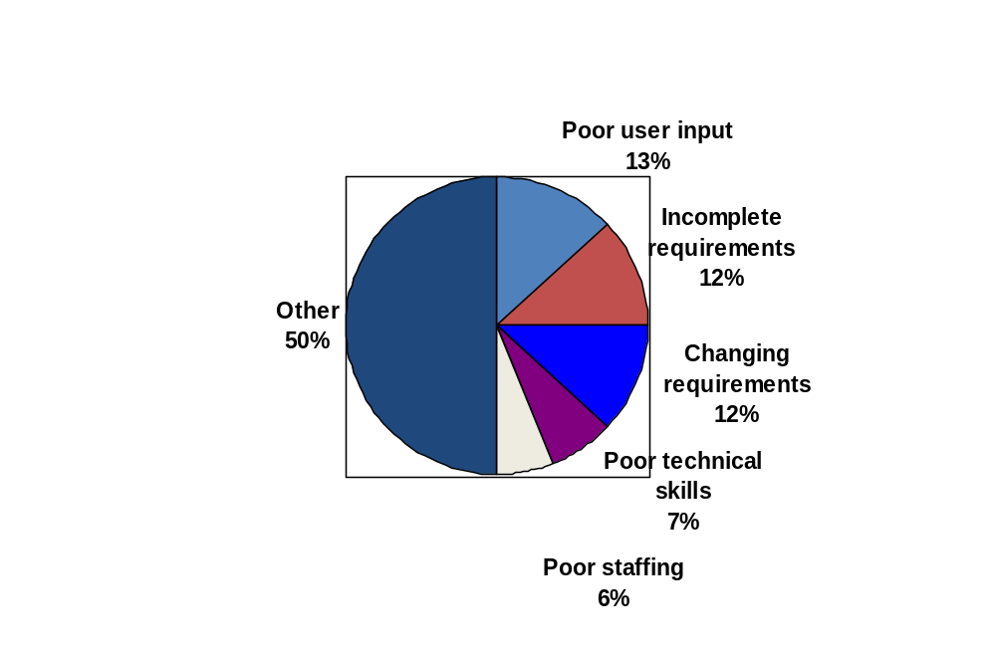
Importance of Requirements Elicitation
37% of problems are related to requirements
Source: Jim Johnson, "Chaos: Charting the Seas of Information Technology."
The Standish Group, 1994.

Slide 10
Importance of Requirements Engineering
50
Relative cost of defect detection/ removal along the lifecycle
20
10
5
2
Average $15K to fix a bug in the field (1991)
1
.5
.2
Requirements
Design
Code
Development
Test
Acceptance
Test
Operation
Berry Boehm 1982

Slide 11
Challenges of Requirements Elicitation
"The hardest single part of building a software systems is deciding precisely what to build. No other part of the conceptual work is as difficult as establishing that detailed technical requirements, including all the interfaces to people, to machines, and to other software systems. No other part of the work so cripples the resulting system if done wrong. No other part is more difficult to rectify later."
Frederick Brooks 1987

Slide 12

Challenges of Requirements Elicitation
As an analyst, I need to know what do you want?
But what do you want to do with the software?
I want you to design the software for me.
I don’t know until you tell me what the software can do.
Well, I can design the software to do anything!
Can you design the software to tell you my requirements?!

Slide 13
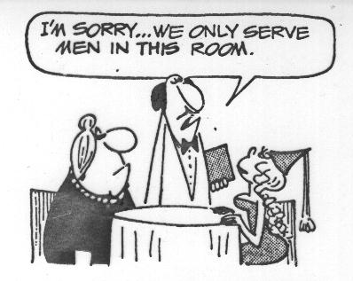
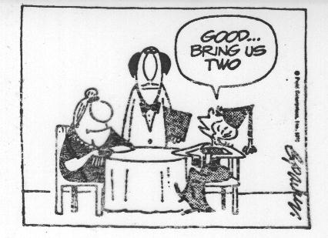
Communication Barrier - Misunderstanding

Slide 14
Challenges of Requirements Elicitation
Software development in general is a wicked problem.
Communication barrier between the team and the customer and users.
  The team does not know the application domain, and the needs of the customer and users.
  The customer and users do not know what the software can do for them.
The importance and challenges of requirements elicitation are often underestimated.
Nonfunctional requirements are not identified or understated.
Requirements change throughout the software lifecycle.

Slide 15
Types of Requirement
Functional requirements – statements of information processing capabilities that the software system must possess.
Nonfunctional requirements include
  Performance requirements
  Quality requirements
  Safety requirements
  Security requirements
  Interface requirements

Slide 16
Examples of Functional Requirements
For a car rental system:
  The system must allow a potential customer to inquire information and availability of rental cars using various combinations of search criteria including make, model, from date, to date, price range, and class (small size, medium size, large size, and luxury cars).
For a study abroad system:
  The system must provide interactive as well as batch-processing means for an OIE (Office of International Education) staff to enter the exchange programs into the database.

Slide 17
Examples of Non-Functional Requirements
Workload:
  The system must be capable of handling a typical workload of 10,000 (ten thousand) inquiries at the same time.
Response time:
  The system's response time must not exceed 3 (three) seconds under the typical workload.

Slide 18
Examples of Quality Requirements
Security:
  The system must protect the contents of the website from malicious attacks and protect the privacy of its users.
Platform independence:
  The system must run on Windows 2000 and later, Unix, Linux, Mac and support popular relational database management systems including Oracle, SQL Server, Access, and MySQL.

Slide 19
Examples of Quality/Interface Requirements
User friendliness:
  The system must provide a user friendly interface that conforms to commonly used web-application user interface look-and-feel and man-machine interaction conventions.
User interface:
  The system must support the following user interfaces:
    web-based
    stand-alone
    voice
    cellular phone

Slide 20
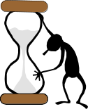

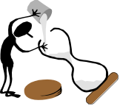






Requirements Elicitation Steps
2. Constructing analysis models, if desired.
1. Collecting information about the application.
3. Deriving requirements & constraints.
5. Reviewing the requirements specification.
4. Conducting feasibility study.

Slide 21
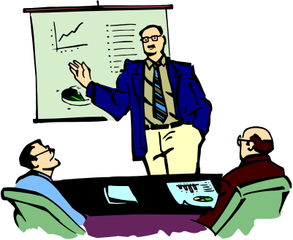
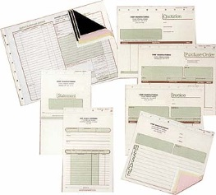






Information Collection Techniques
business
forms
operating
procedures
regulations &
standards
Customer presentation
Literature survey
Writing user stories
Stakeholder survey
User interviewing

Slide 22
Focuses of Information Collection Activities
What is the business, the current business situation, and how does it operate?
What is the system’s environment or context?
What are existing business processes, their input and output, and how do they relate to each other?
What are the problems with the current system?
What are the business or product goals?
Who are the users of the current and future systems, respectively?
What do the customer and users want, and what are their business priorities?
What are the quality, performance, and security considerations?

Slide 23

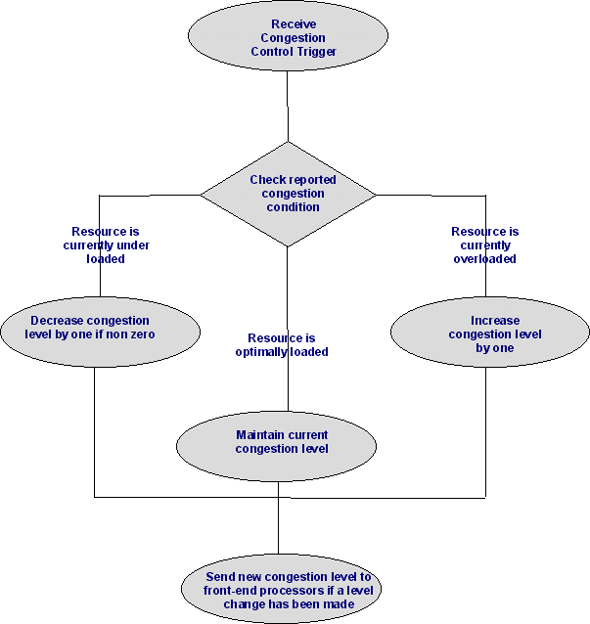
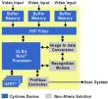



Constructing Analysis Models
fac
xxx
vvv
bbb
nnn
Intuitive models
fac1
fac2
Purpose: to aid understanding
of the application, requirements,
and constraints.
yyy
jjj
Formal or informal models

Slide 24
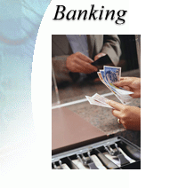




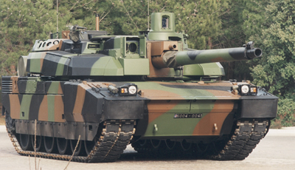




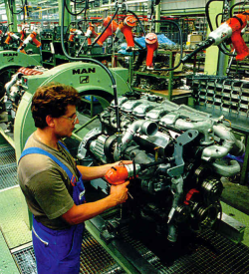

Businesses in Different Domains
Finance
Insurance
Health Care
Transportation
Defense
Telecommunication
Retailing
and more
government
Education
Energy
Manufacturing

Slide 25
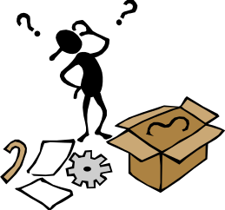
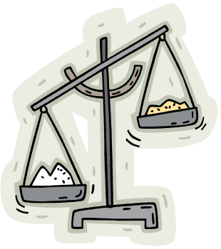




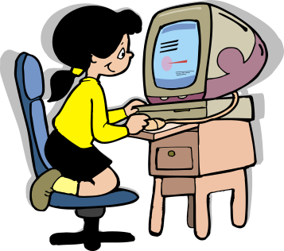
Deriving Requirements and Constraints
Current Situation
Discrepancies/
Problems
Industry standards
and government
policies
Business Goals
Needs & wish list
Software Requirements Specification
Requirements & constraints

Slide 26

Priorities and Timing
Ask the customer and users
  How much would he/she pay to
  include a given requirement?
    for example, between $1 and $100, how much he/she would pay to have it delivered?
  How soon would he/she like the requirement delivered?
  Between $X and $Y, how much would he/she pay to have it delivered in this version than in next version?

Slide 27
Requirements Specification
1. Introduction to Document
1.1 Purpose of Product
1.2 Scope of Product
1.3 Acronyms, Abbreviations, Definitions
1.4 References
1.5 Outline of the Rest of the SRS
2. General Description of Product
2.1 Context of Product
2.2 Product Function
2.3 User Characteristics
2.4 Constraints
2.5 Assumptions and Dependencies
3. Specific Requirements
3.1 External Interface Requirements
3.1.1 User Interfaces
3.1.2 Hardware Interfaces
3.1.3 Software Interfaces
3.1.4 Communication Interfaces
3.2 Functional Requirements
3.2.1 Class 1
3.2.2 Class 2
3.2.3 ...
3.3 Performance Requirements
3.4 Design Constraints
3.5 Quality Requirements
3.6 Other Requirements
4. Appendices
IEEE SRS Standard by Objects, 1998

Slide 28
Requirements Specification
1. Introduction to Document
1.1 Purpose of Product
1.2 Scope of Product
1.3 Acronyms, Abbreviations, Definitions
1.4 References
1.5 Outline of the Rest of the SRS
2. General Description of Product
2.1 Context of Product
2.2 Product Function
2.3 User Characteristics
2.4 Constraints
2.5 Assumptions and Dependencies
3. Specific Requirements
3.1 Functional Requirements
3.1.1 Functional Requirement 1
3.1.1.1 Introduction
3.1.1.2 Inputs
3.1.1.3 Processing
3.1.1.4 Outputs
3.1.2 Functional Requirement 2
...
3.2 External Interface Requirements
3.1.1 User Interfaces
3.1.2 Hardware Interfaces
3.1.3 Software Interfaces
3.1.4 Communication Interfaces
3.3 Performance Requirements
3.4 Design Constraints
3.4.1 Standards Compliance
3.4.2 Hardware Limitations
...
3.5 Attributes
3.5.1 Availability
3.5.2 Security
3.5.3 Maintainability
...
3.6 Other Requirements
3.6.1 Database
3.6.2 Operations
...
4. Appendices
IEEE SRS Standard 830-1984

Slide 29
Feasibility Study
Not all projects are practically doable with technology, time, and resource constraints.
Feasibility study aims at determining if the project is doable under the given constraints.
Feasibility study in RE is concerned with
  the feasibility of the functional, performance, nonfunctional, and quality constraints
  adequacy of the technology
  timing and cost constraints
  constraints imposed by the customer, industry and government agencies

Slide 30
Requirements Verification and Validation
Verification: Are we building the product right?
  Are we building the product in the right way?
  It concerns the product building process.
Validation: Are we building the right product?
  Are we building the product that the customer wants?
  It concerns the correctness of the product being built.

Slide 31
Three Types of Requirements Review
Technical review is an internal review performed by the technical team. Techniques include:
  peer review, peers are guided by a review questionnaire
  walkthrough, the analyst explains each requirement while the reviewers examine it and raise doubts
  inspection, inspector is guided by a checklist of commonly encountered problems in SRS (e.g., incompleteness, duplicate definition, inconsistency, etc.)

Slide 32
Three Types of Requirements Review
Expert review means review of the requirements specification by domain experts.
Customer/user reviews are performed by involving the customer and/or users of the system.

Slide 33
Using Review/Inspection Lists
Develop different peer review questionnaires and inspection checklists for different types of review:
peer review
inspection
technical
review
internal
review questionnaire
internal inspection
checklist
expert
review
expert
review questionnaire
expert inspection
checklist
customer
review
customer
review questionnaire

Slide 34
Applying Agile Principles
Customer collaboration and active user involvement are imperative.
Capture requirements at a high level; leave the detail to subsequent iterations.
Good enough is enough---produce a list of prioritized software requirements quickly and move on to the next step.
Just barely enough modeling---construct the minimum model quickly, just enough to serve the purpose and no more.

